Slide 1

Campus Hack 2021

Slide 2
Our Team: Kryptophiles
Atharva Dabli (2020CS10328)
Kushagra Rode (2020CS10354)
Shreya Sonone (2020CS10384)

Slide 3

Our BOT:
Name: ‘MAUSAM’ Platform: Discord
This discord bot is a user-friendly weather bot which will tell you all the weather related information you will ask for!

Slide 4
Usability
The main use of our bot is to tell the weather details of any place, the air quality index and AQI alerts, weather alerts of any place.
How it is helpful and unique?
Don’t have time to read news and unaware of the upcoming harsh weather? This bot can give you quick alerts!
Want to know air quality and if its safe to go outside? This bot gives you AQI related information.
Planning a trip to a place with your travel squad on discord and want to know the weather forecast there? This is the perfect bot for your travel squad server!
This bot is handy and just a command away for all your weather related queries!

Slide 5
Timeline
Step 1
Deciding and sharing different Bot ideas.
Step 2
Step 3
Getting the API key and URL for information.
Creating and naming our bot on discord developer portal.

Slide 6
Timeline
Step 4
Writing basic code for the bot.
Step 5
Making improvements in the code and introducing more commands.
Step 6
Debugging and finalizing the bot.

Slide 7

Tasks and Commands of Mausam

Slide 8
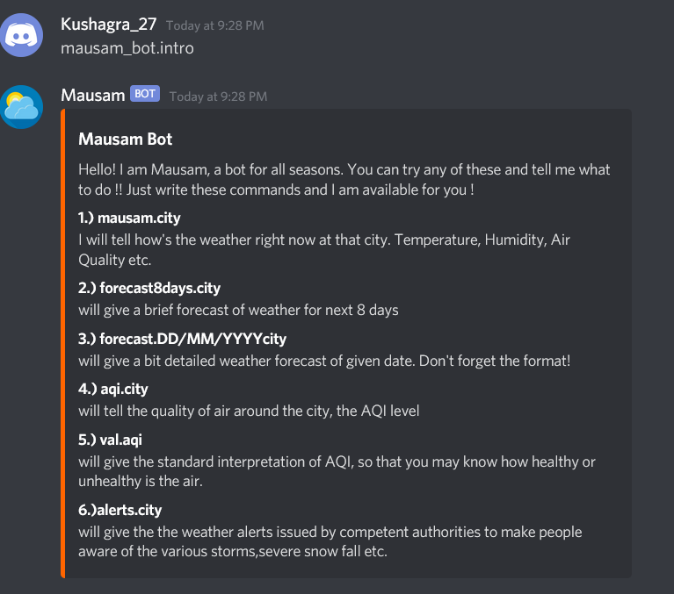
mausam_bot.intro
On sending this command, Mausam tells you the details of different commands which it can follow.
On the right side you can see the message sent by mausam on this command.
*Make sure you don’t add anything else after mausam_bot.intro*

Slide 9
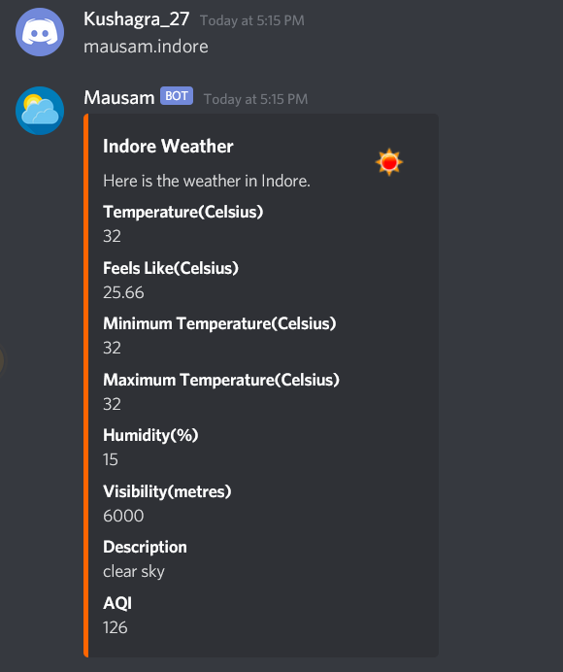
mausam.location
On sending this command, Mausam will tell you the present day weather details of the location(a city name) you have asked for.
On the right side you can see all the present day weather details of Indore.
*Make sure to enter the correct spelling of the location*

Slide 10
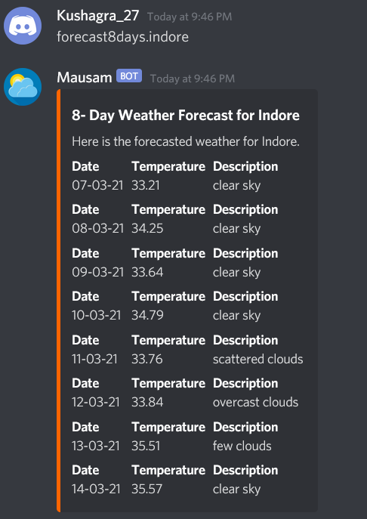
forecast8days.location
On sending this command, Mausam will give you the weather details of 8 consecutive days starting from present day.
On the right side you can see an example of what details will be shown.

Slide 11
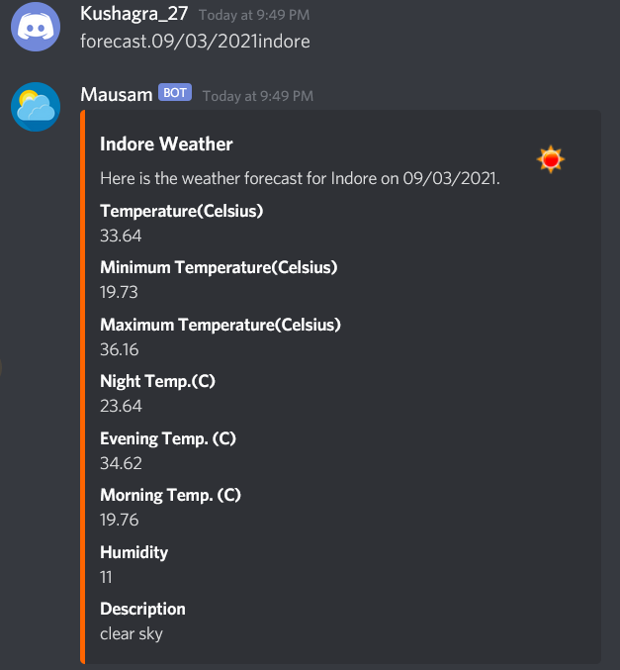
forecast.datelocation
On sending this command Mausam will give you the weather details of the desired location on the desired date
Make sure to enter this command strictly in this format- forecast.dd/mm/yyyylocation
example- forecast.09/03/2021indore

Slide 12
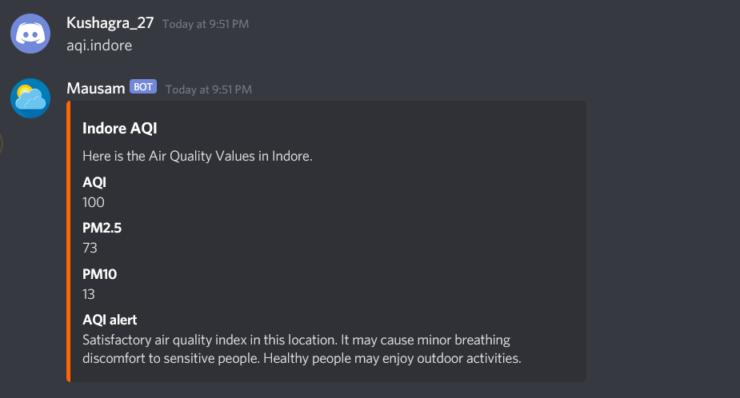
aqi.location
On sending this command, mausam will let you know details of the air quality of the location.

Slide 13
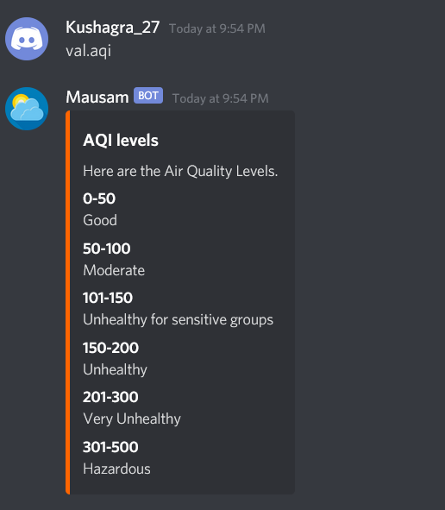
val.aqi
On sending this command, mausam will let you know the various ranges of AQI and what their effect is!

Slide 14
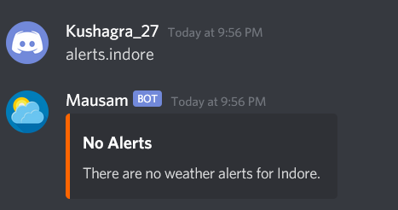
alerts.location
On sending this command, Mausam will let you know if there are any news alerts in the next 8 days.
If there are no alerts, it will simply give you a No Alert response.

Slide 15
Scalability
Our bot is very scalable. It can be easily upgraded to give more information like historical weather details, forecasted weather, news alerts, advanced weather maps etc.
This would increase the utility of this bot.

Slide 16

Demo
This Photo by Unknown Author is licensed under CC BY-NC-ND

Slide 17

Thank you!
This Photo by Unknown Author is licensed under CC BY-NC-ND

